Slide 1
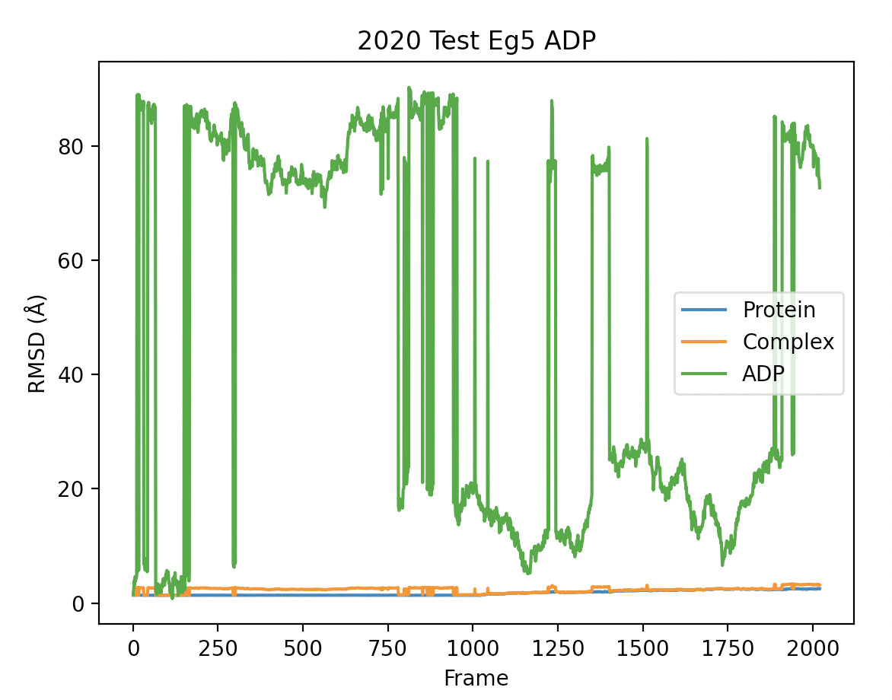
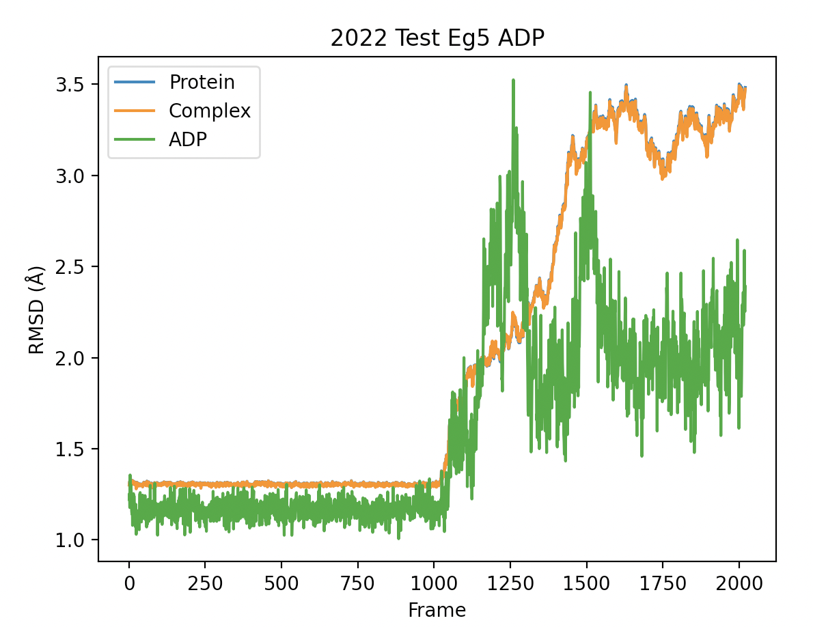
2020 vs 2022 system

Slide 2
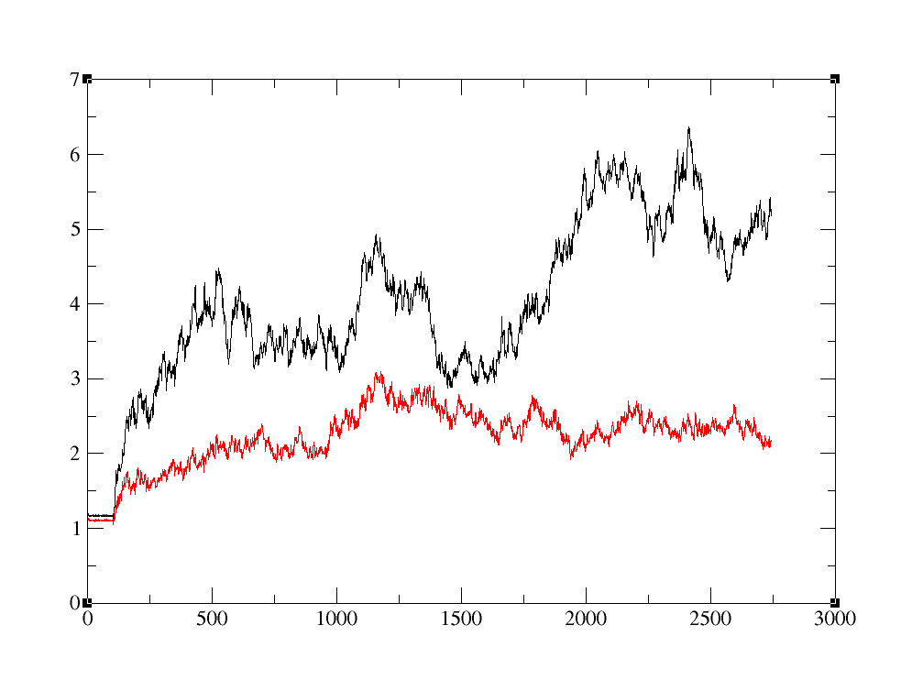
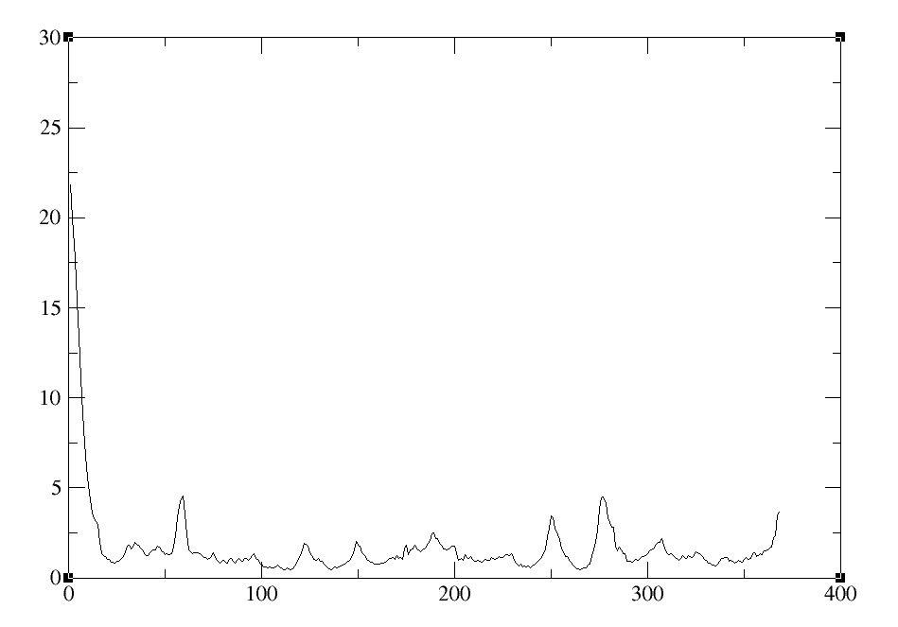
RMSD of ASN18-GLU364
All residues
RMSF (Å)
RMSD (Å)
18-364
Frame
Residue

Slide 3
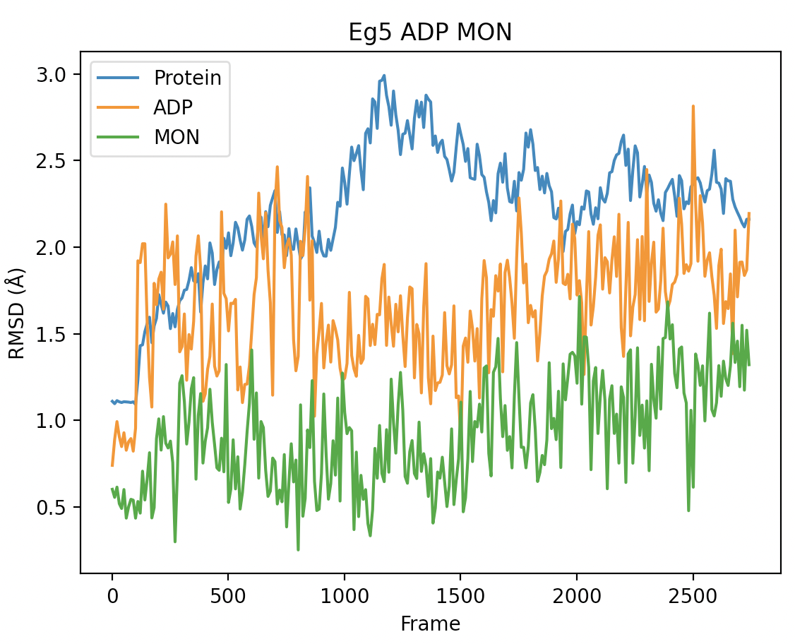
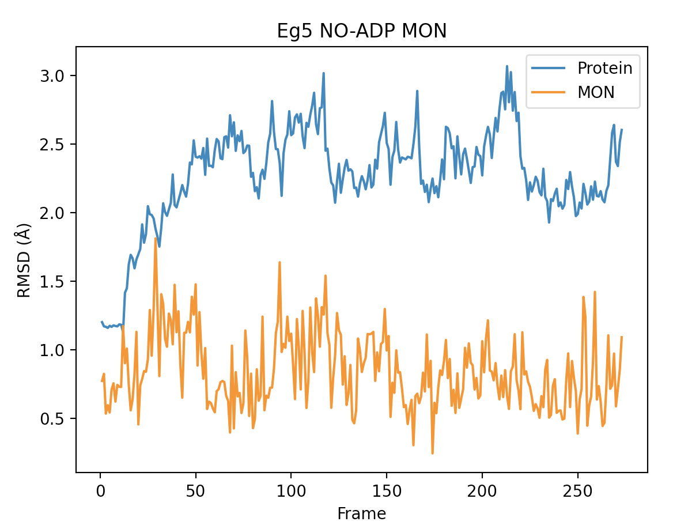
25ns of ADP bound and no ADP Eg5

Slide 4
Eg5
14Jul2022

Slide 5
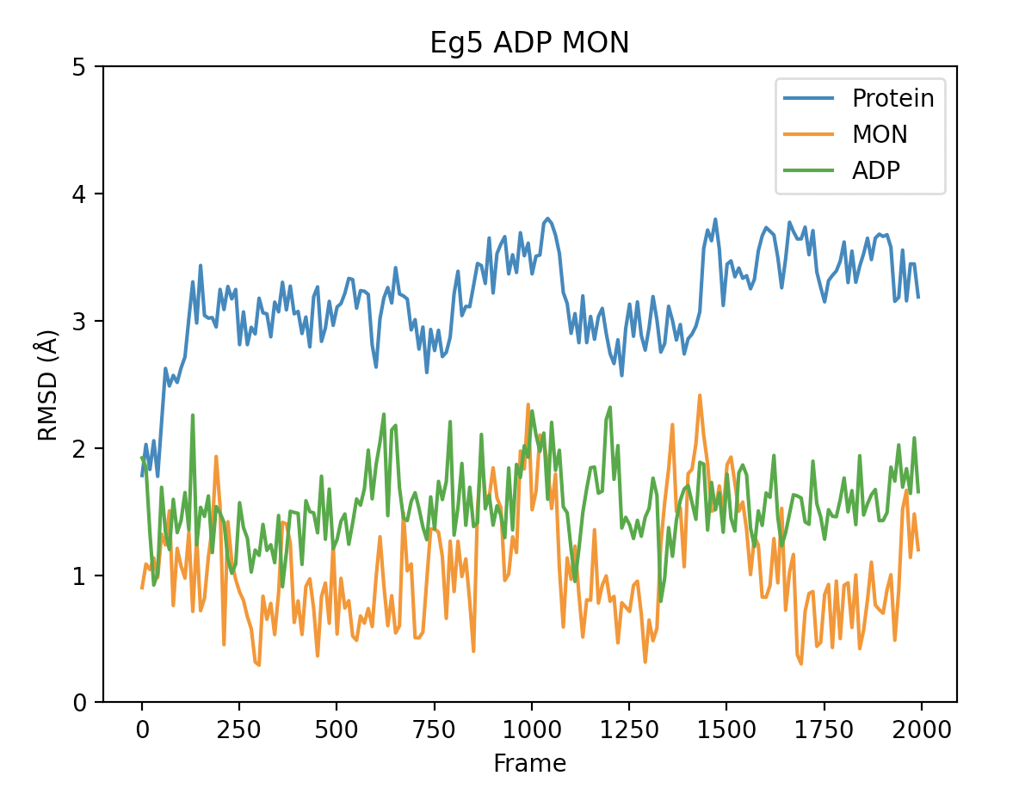
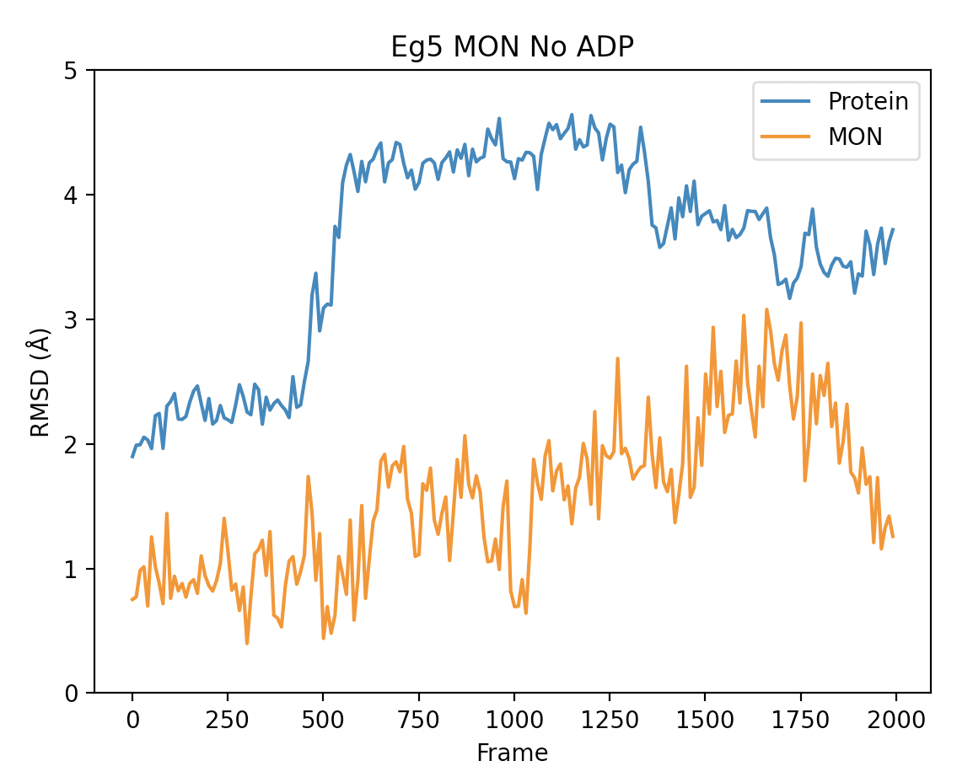
Eg5: 200ns of standard simulation
Notes:
RMSF for this movement

Slide 6
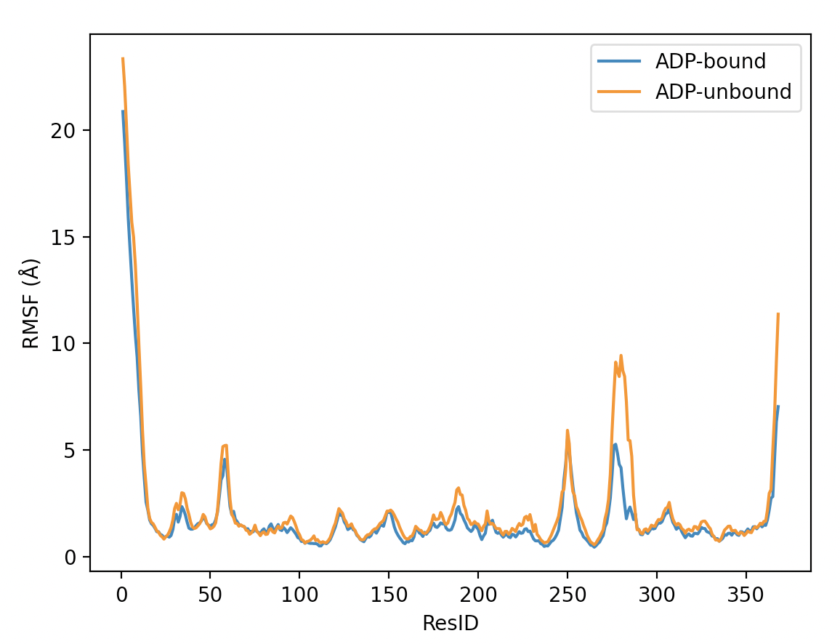
200ns RMSF
Notes:
275-285 is more dynamic in the unbound simulation

Slide 7
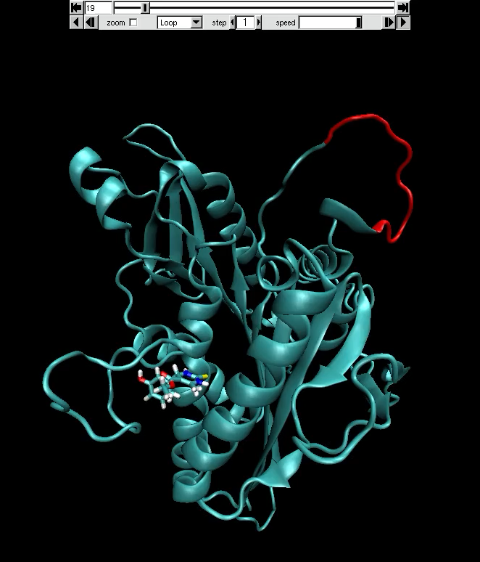
275-285 and slight Monastrol Change

Slide 8
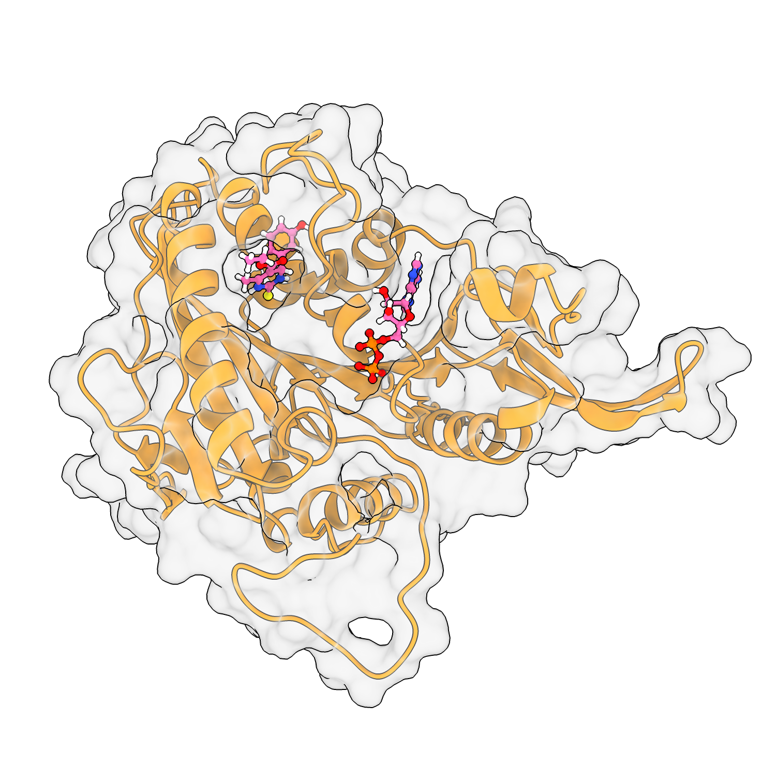
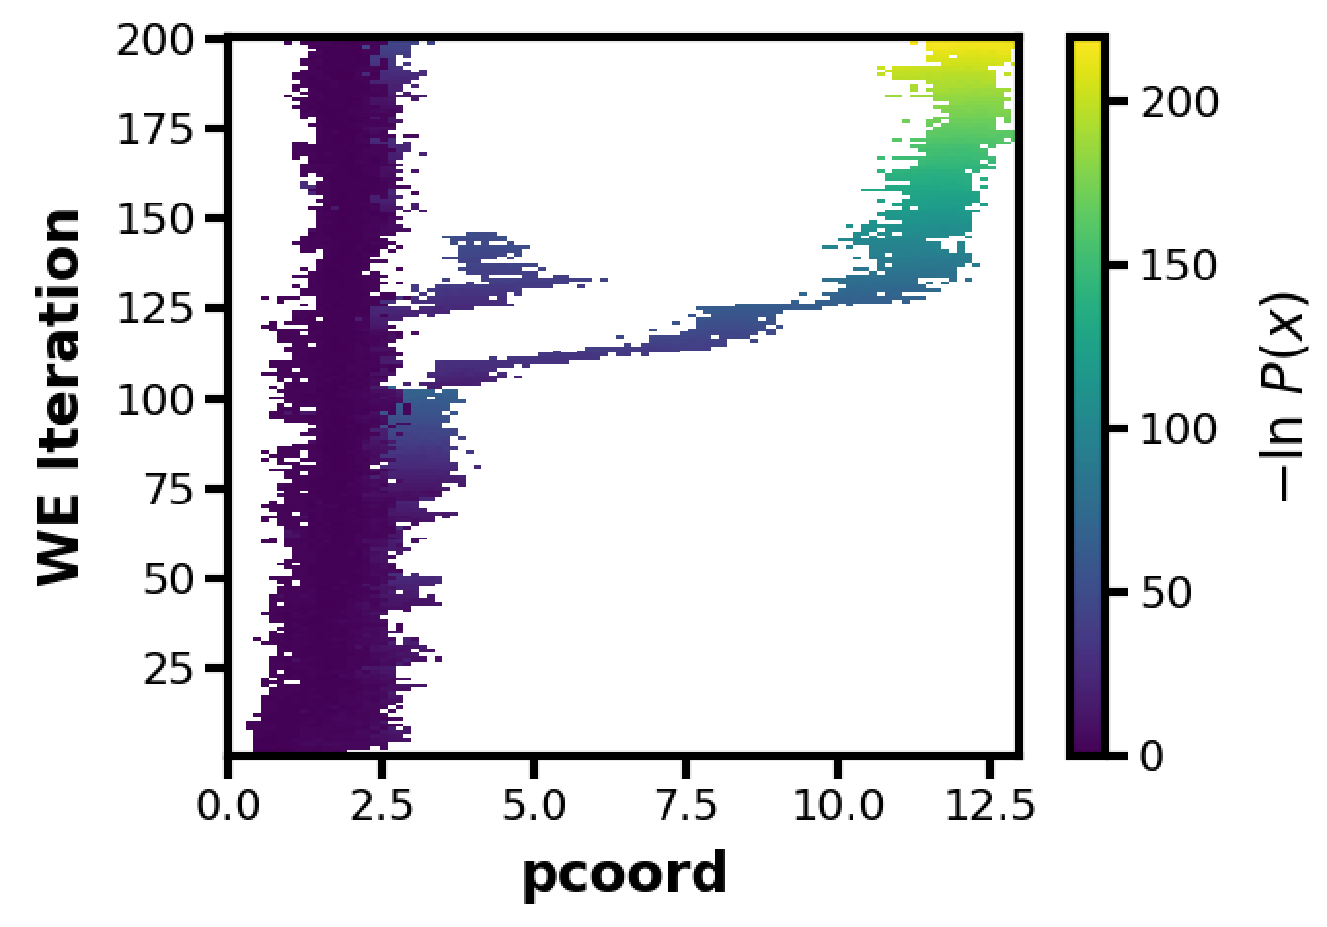
Eg5 ADP Unbinding
= ADP Base RMSD (Å)

Slide 9
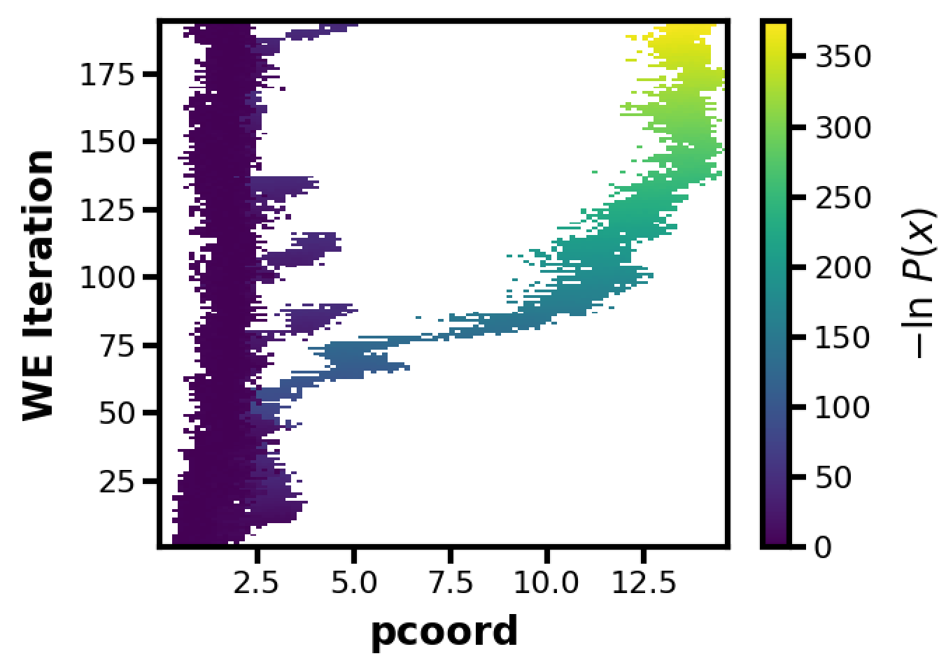
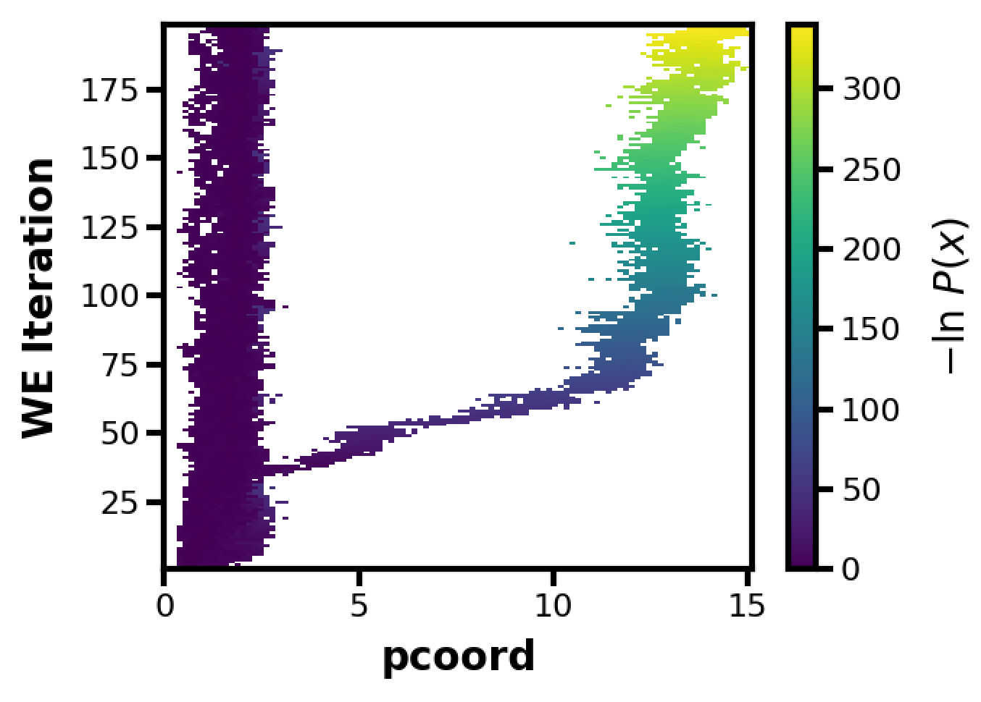
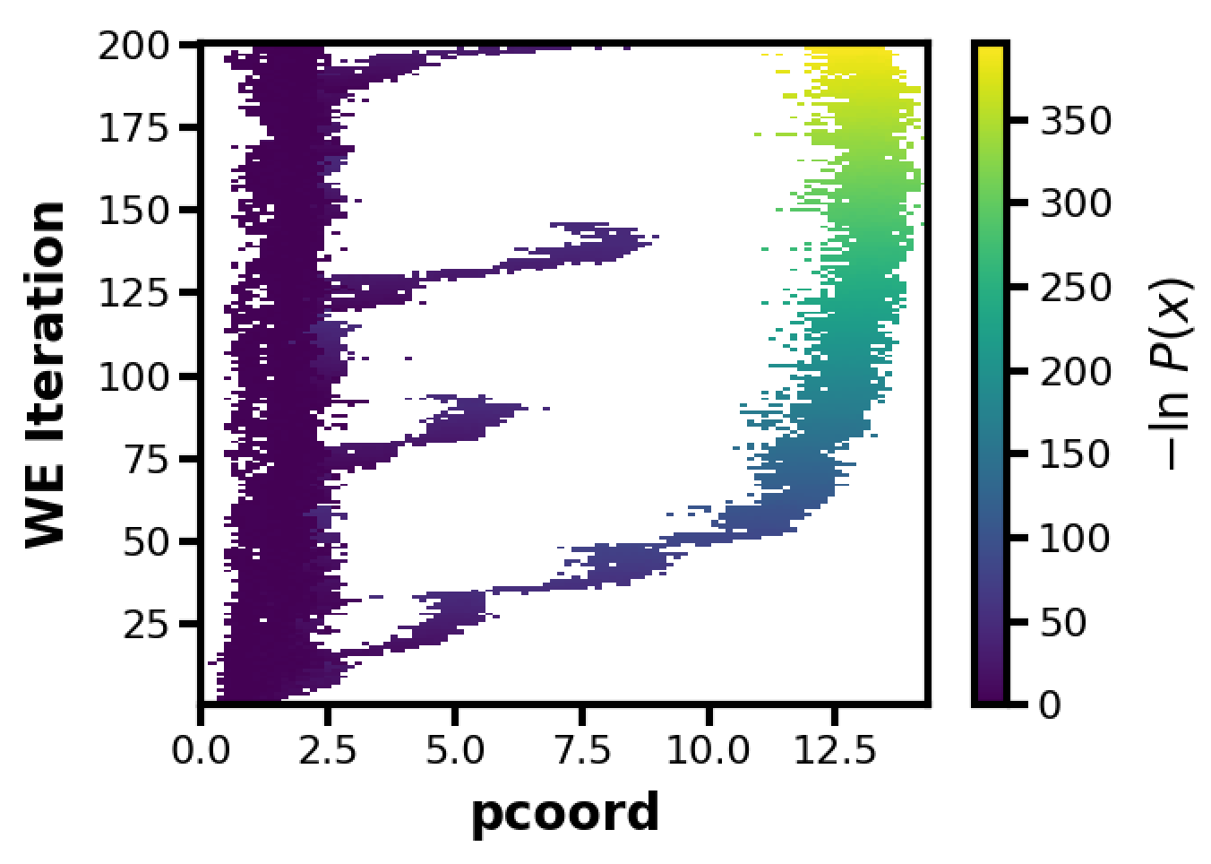
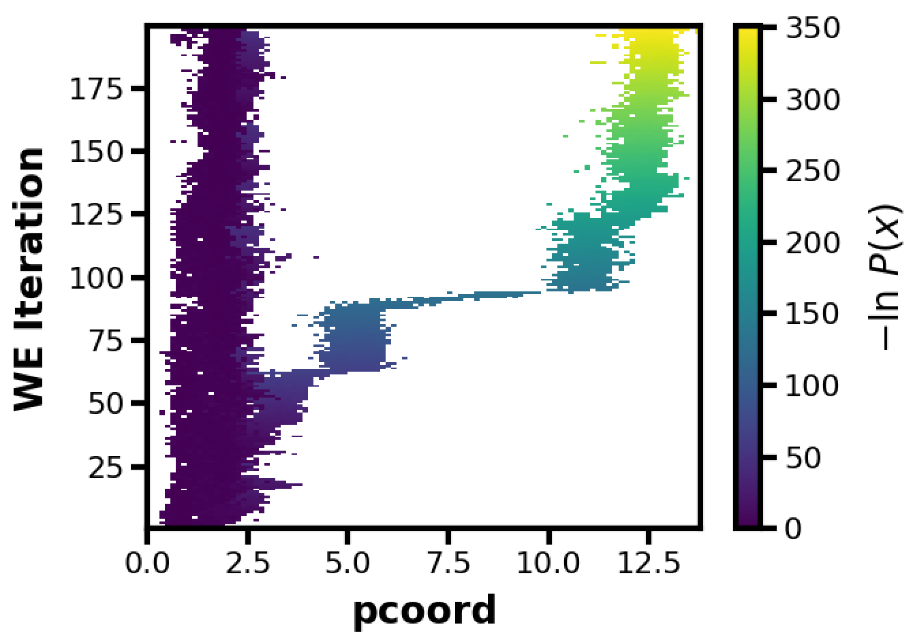

Slide 10
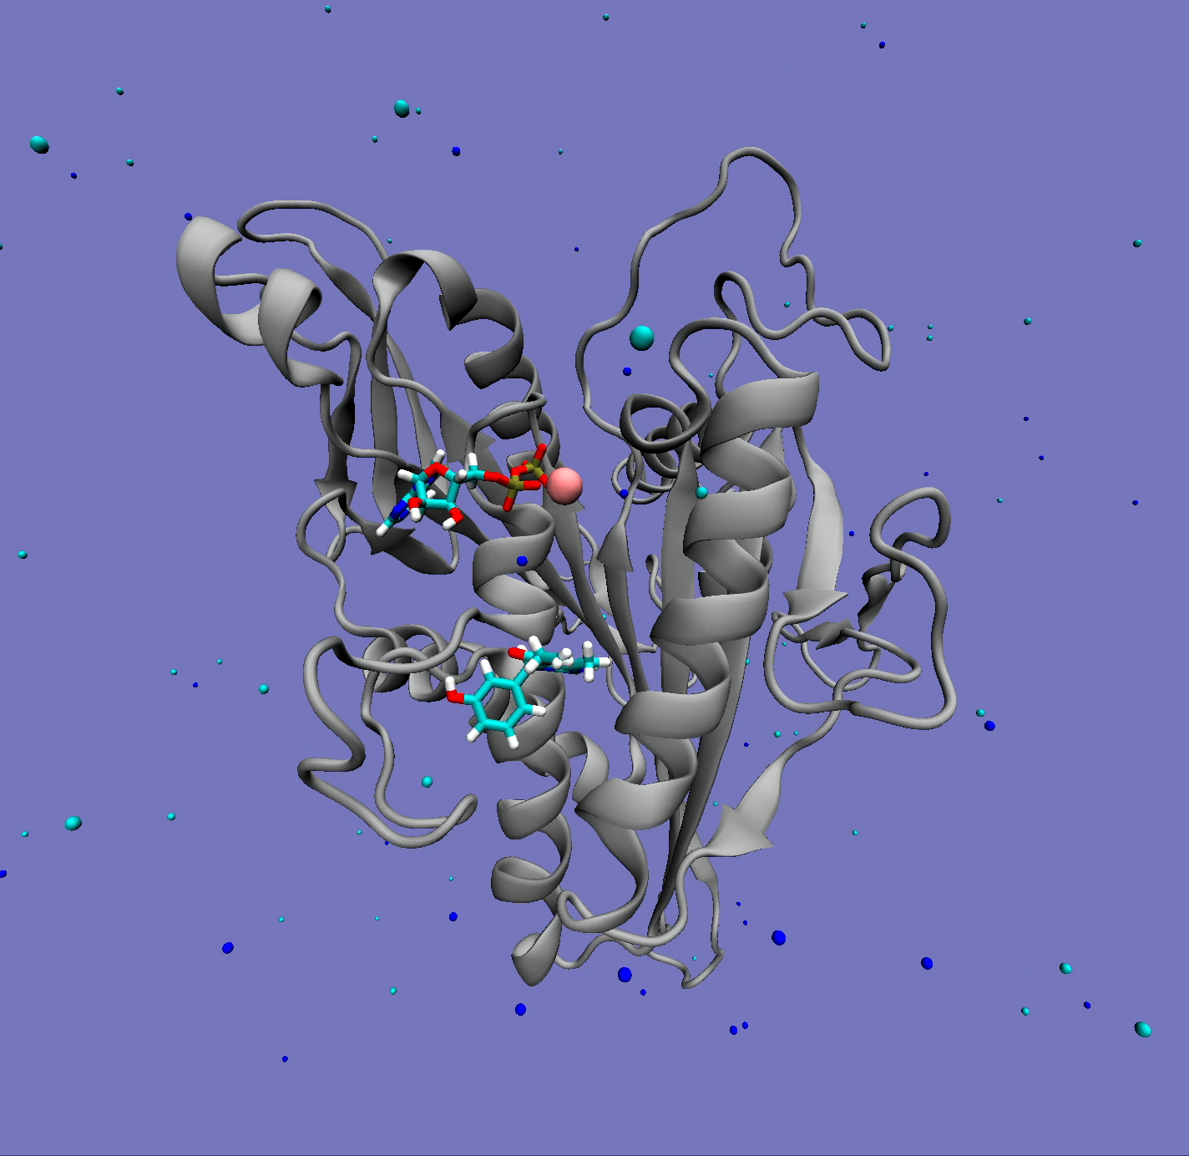
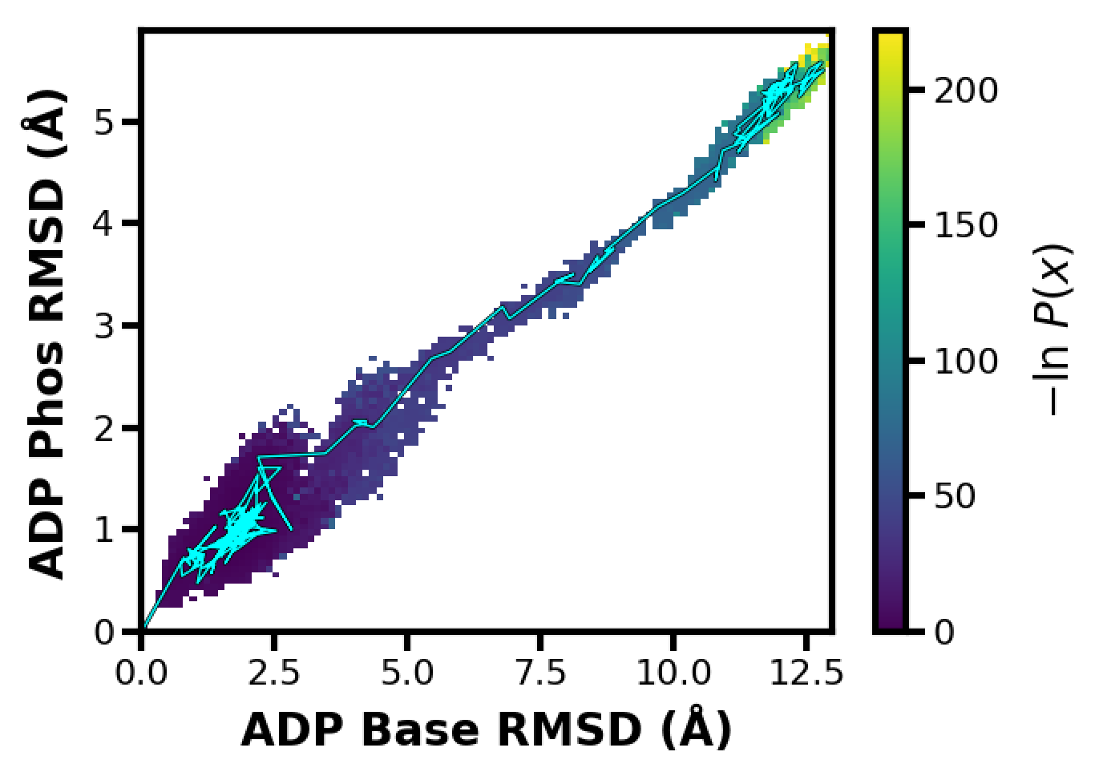
What’s the pathway?
Notes:
Look at Mg2+ interactions of complex
Try Mg RMSD, try Mg and ADP Phos RMSD

Slide 11
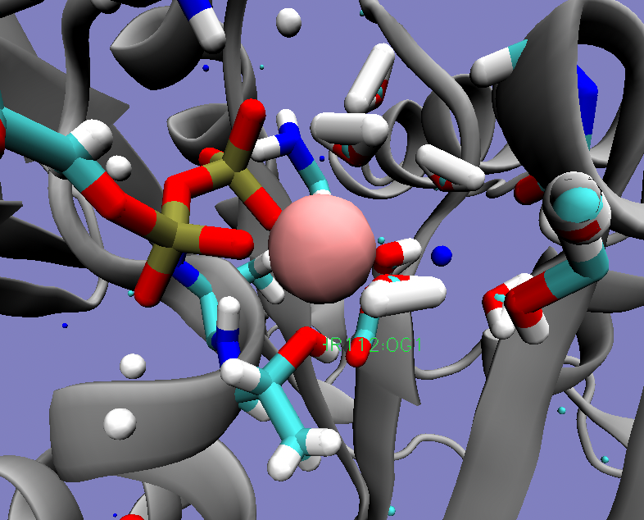
What’s the pathway?
Mg2+ interacts with PO₄ , WAT, and THR112
Notes:
Look at Mg2+ interactions of complex
Try Mg RMSD, try Mg and ADP Phos RMSD

Slide 12
How can we select for a more productive pathway?
Testing out weight thresholds:
1e-12 = ~25kT (Dickson Lab)
1e-22 = ~50kT

Slide 13
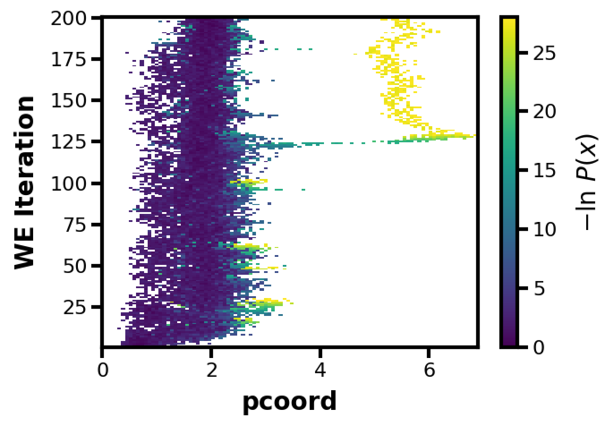
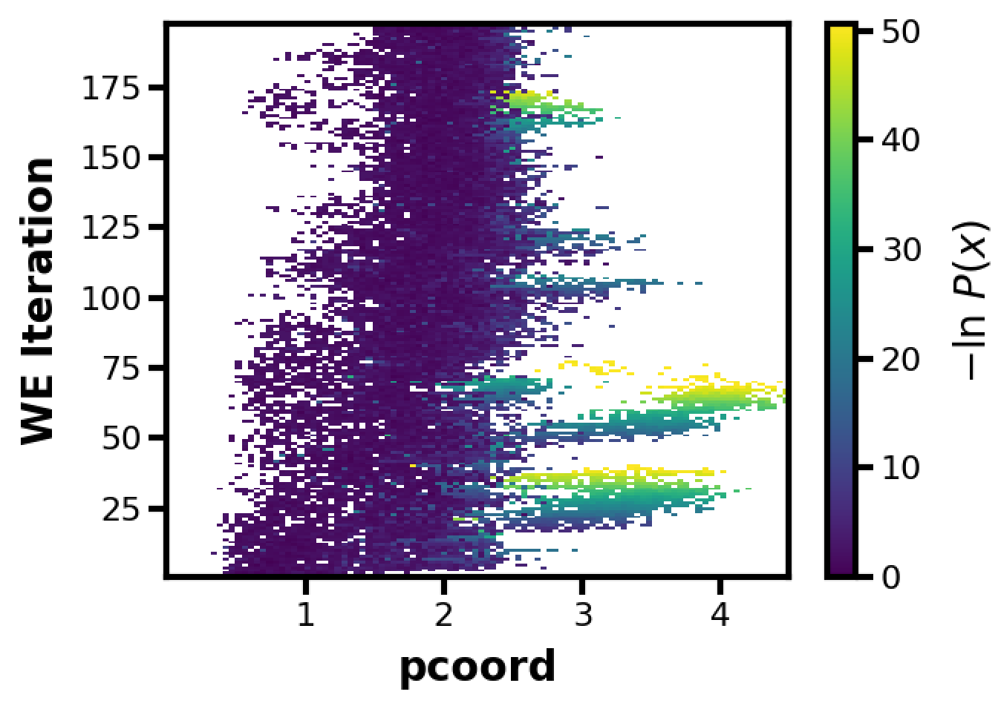
1e-12 VS 1e-22

Slide 14
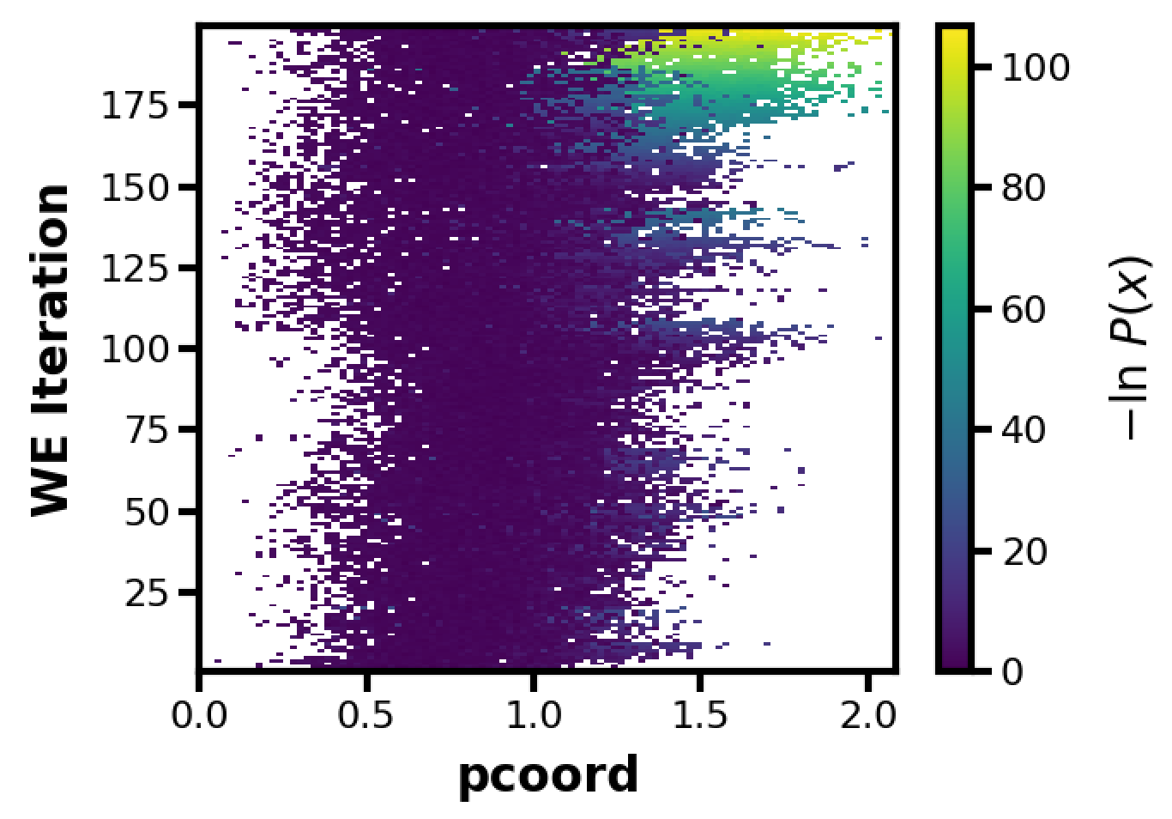
Testing a 1D Mg RMSD Pcoord

Slide 15
27Jul2022

Slide 16
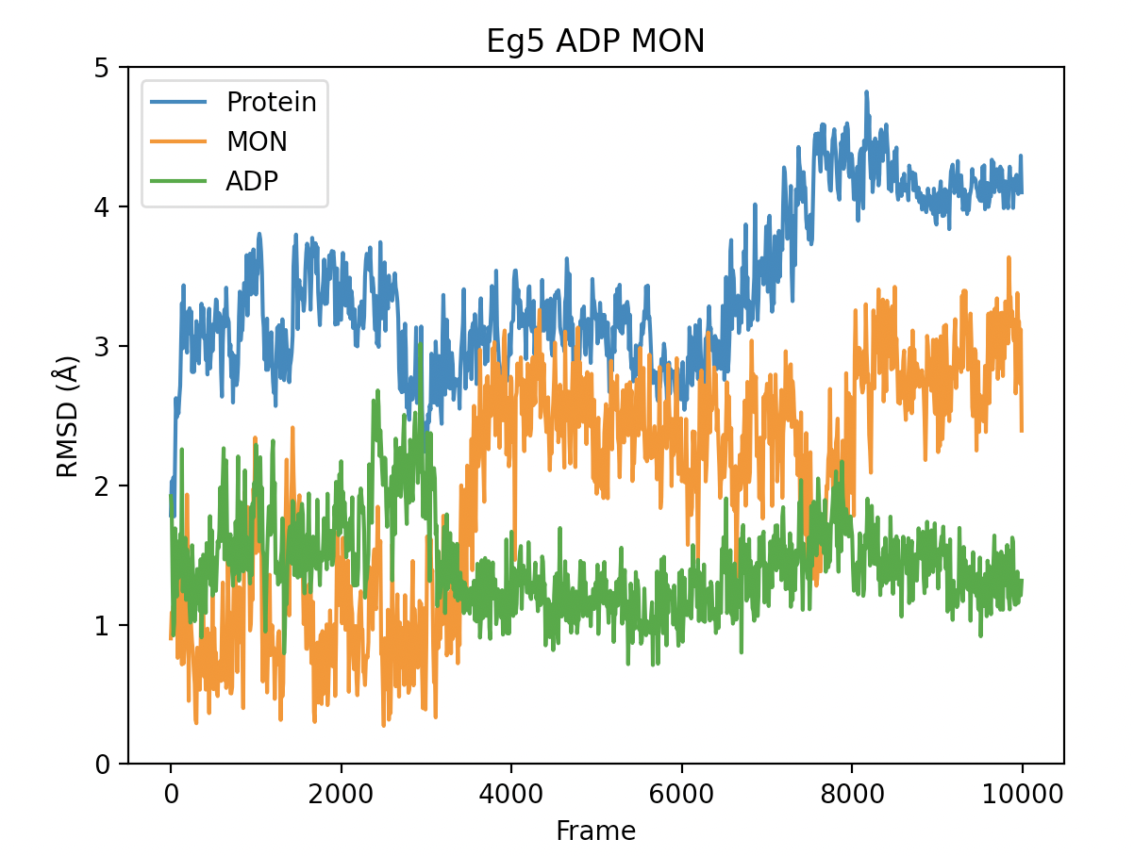
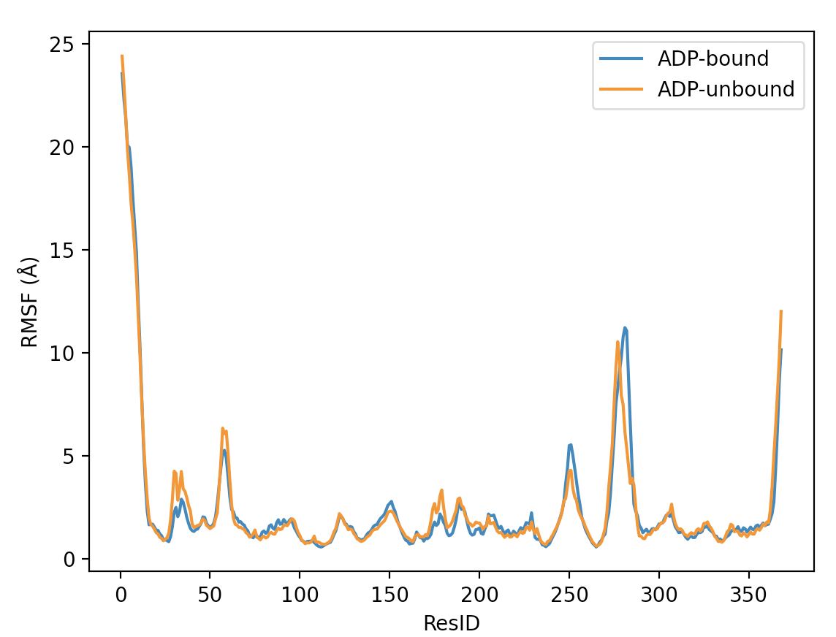
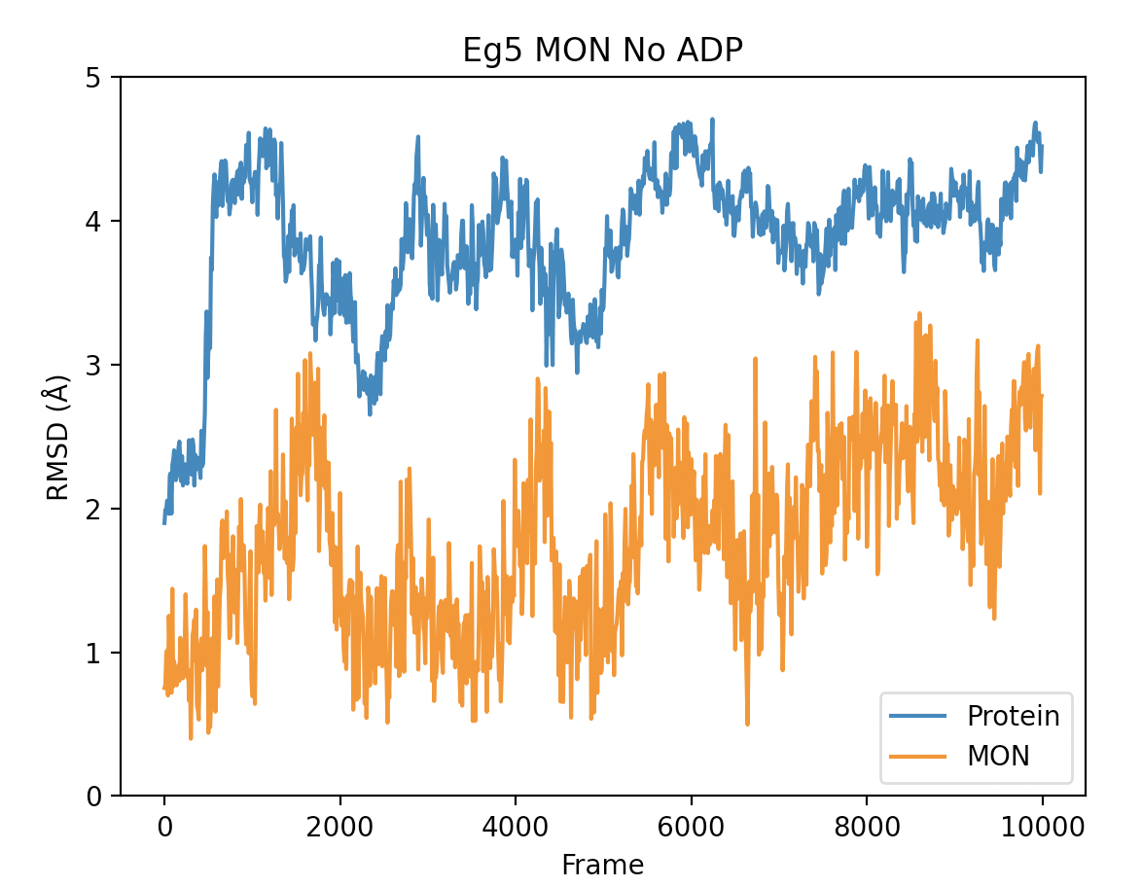
1µs of Eg5/Mon with and without ADP

